Slide 1








Comp6236
SE & Cyber Security week 1
Dr Md Sadek Ferdous
www.CyberSecuritySoton.org
@CybSecSoton (fb & tw)

Slide 2
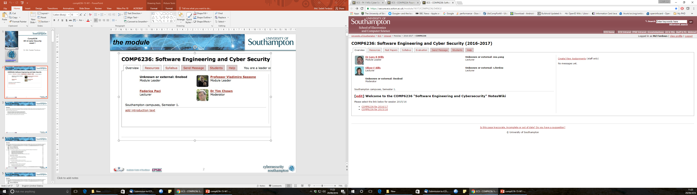



the module

Slide 3
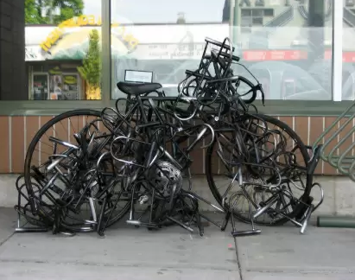
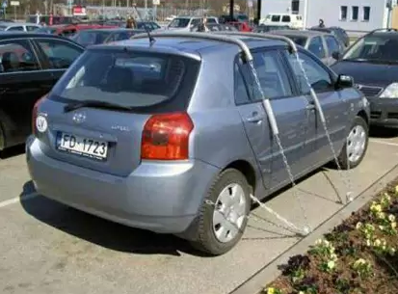
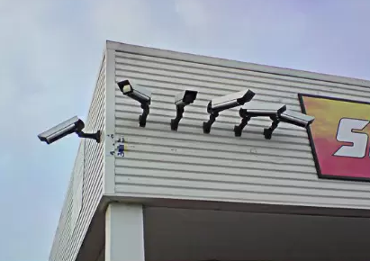
Sense of Security
http://img.memecdn.com/security-fails_o_2219379.webp

Slide 4
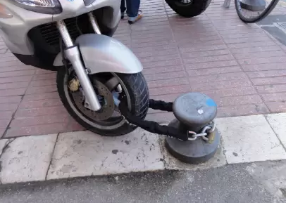
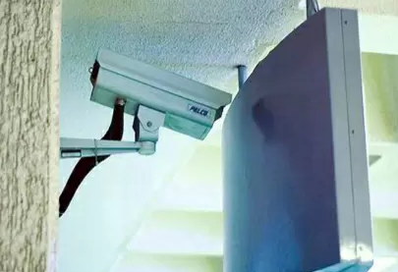
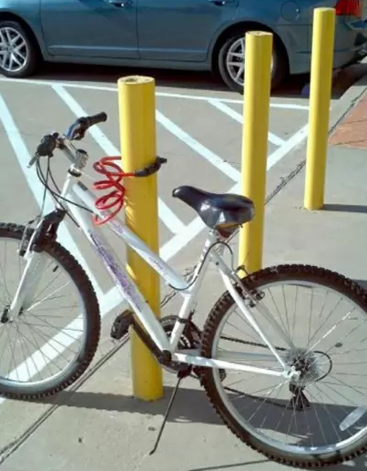
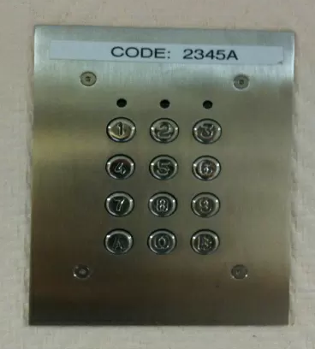

(False) Sense of Security
http://img.memecdn.com/security-fails_o_2219379.webp

Slide 5
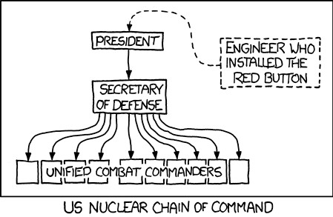
chain of command
http://xkcd.com/898/

Slide 6
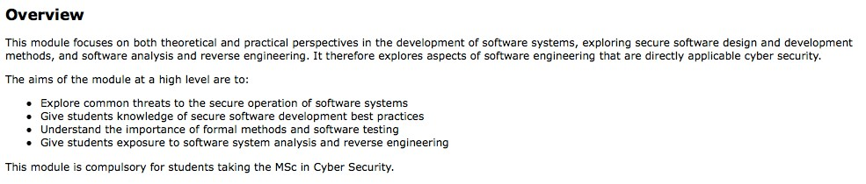
aims & objectives
3

Slide 7

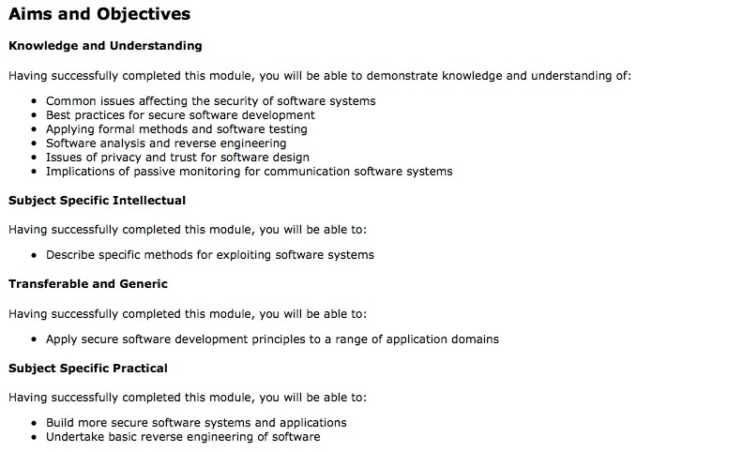
aims & objectives
3

Slide 8
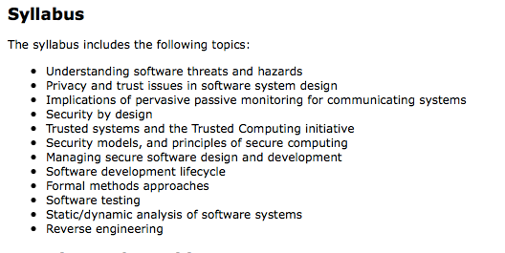
syllabus

Slide 9


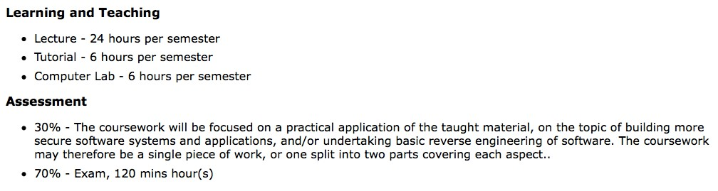
aims & objectives
3

Slide 10
plan of lectures (1)
W1 (SF) | Introduction to the Course
 | Secure Software Development Life Cycle | Chapter 1-3: Software Security – Building Security In
 | Security and Usability | Academic Papers
W2 (MY) | Introduction to Security Risk Analysis
 | CORAS | Model-Driven Risk Analysis – Chapter 3: A guided tour for the CORAS method
 | CORAS Exercise | Model-Driven Risk Analysis – Chapter 3: A guided tour for the CORAS method
W3 (MY) | Security Requirements ; SQUARE
 | Security Requirements – Abuse Cases | Chapter 8; Software Security – Building Security In
W4 (SF) | Secure Software Architecture and Design ; Threat Modelling ; STRIDE | Chapter 9 ; The Security Development Life Cycle
 | Threat Modelling ; STRIDE | Chapter 9 ; The Security Development Life Cycle
 | Secure Software Architecture and Design ; Threat Modelling – LINDDUN – Misuse Cases
W5 (SF) | Designing Secure Architectures Using Software Patterns | E. B. Fernandez. Security Patterns In Practice, Chapters 1-2
W6 (MY) | Risk-Based Software Testing, Model Checking and Software Verification

Slide 11
plan of lectures (2)
W7 (OB) | Low-Level Software Vulnerabilities | Viega, McGraw. Building Secure Software. Chapter 7
 | Low-Level Software Vulnerabilities - Defenses | Viega, McGraw. Building Secure Software. Chapter 7.
 | Lab
W8 (OB) | Low-Level Software Vulnerabilities | Viega, McGraw. Building Secure Software. Chapter 7
 | Low-Level Software Vulnerabilities - Defenses | Viega, McGraw. Building Secure Software. Chapter 7.
 | Lab
W9 (OB) | Static and Dynamic Analysis of Code
 | Tutorial
 | Lab
W10 (OB) | Malware Analysis and Reverse Engineering Part 1
 | Tutorial
 | Lab
W11 (OB) | Malware Analysis and Reverse Engineering Part 2
 | Tutorial
 | No Lab

Slide 12
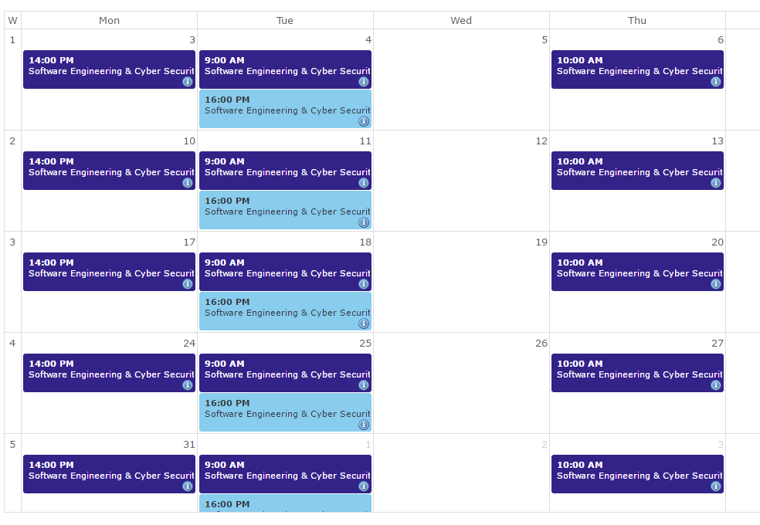
Weekly schedule

Slide 13
Secure Software Development Life Cycle
Comp6236
(slides by Laurie Williams)
www.CyberSecuritySoton.org
@CybSecSoton (fb & tw)

Slide 14


Vulnerabilities/Attacks
Vulnerability¹ - a fault in software that allows an attacker to use it to violate a reasonable security policy for that system.
Attack² - techniques that attackers use to exploit the vulnerabilities in applications.
http://cve.mitre.org/about/terminology.html
https://www.owasp.org

Slide 15
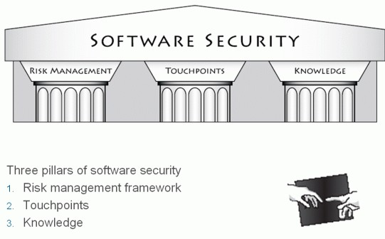
http://www.buildsecurityin.com/images/pillars.gif

Slide 16
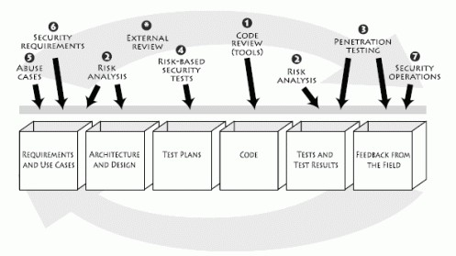
Software Security Touchpoints
Numbered according to eﬀectiveness and importance or their “natural utility” per Gary McGraw in “Software Security”
http://www.cigital.com/justiceleague/wpLcontent/uploads/2007/07/ touchpoints.gif

Slide 17
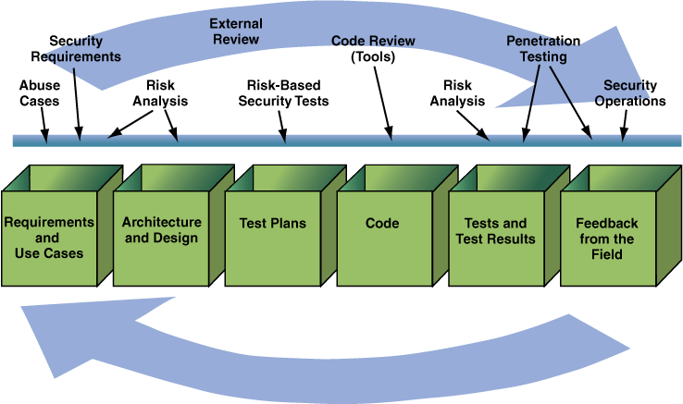
SDLC With Defined Security Touchpoints
SDLC: Software Development Life Cycle
McGraw, Gary. Software Security: Building Security In. Boston, MA: Addison-Wesley Professional, 2006.

Slide 18
Touchpoints (1 of 4)
15
Code review with a tool
Artifact: Code
Static analysis tools to identify common vulnerabilities
Example: buﬀer overﬂow
Architectural risk analysis
Artifact: Design and speciﬁcation
Inspections and analysis approaches
Example: lack of authentication

Slide 19
Touchpoints (2 of 4)
16
Penetration testing
Artifact: Running system
Use application like an attacker
Example: Information leakage
Risk-based security testing
Artifact: Running system
Security features and attack patterns/misuse cases
Example: Elevation of privilege

Slide 20
Touchpoints (3 of 4)
17
Abuse (misuse) cases
Artifact: Requirements
Think like an attacker
Example: Spooﬁng
Security requirements
Artifact: Requirements
Functional security requirements and emergent security properties
Example: No explicit description of necessary data protection

Slide 21
Touchpoints (4 of 4)
18
Security operations (not covered as much in this class)
Artifact: Fielded system
Network security, ﬁrewalls
Example: Intrusion detection

Slide 22
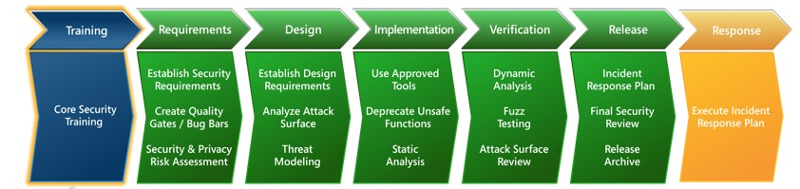
Security Development Lifecycle (SDL): What is it?
A software development security assurance process consisting of security practices
Aﬀects all steps in the lifecycle and the development culture
Simpliﬁed SDL has 17 practices (see ﬁgure below)
Uses a build security in/secure by design philosophy

Slide 23

Origins
2002: Bill Gates announces the Trustworthy Computing Initiative
2004: Turned into a structured process, the SDL (http://microsoft.com/sdl)
Evolved to Version 5.2 in 2012, Version 6.0 in 2013
Microsoft oﬀers many (free) tools and templates to support SDL
“Trustworthy Computing is the highest priority for all the work we are doing. We must lead the industry to a whole new level of Trustworthiness in computing.”
12
http://www.greatpriceshere.com/2008/06/30/billLgatesLdethroned/

Slide 24
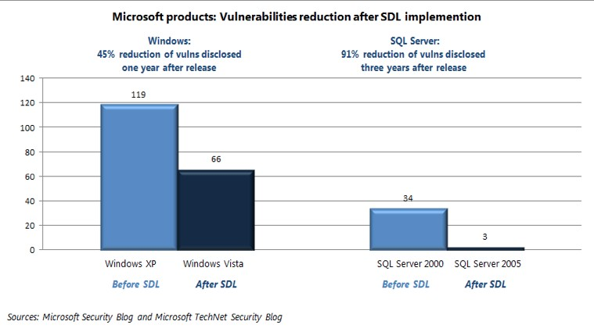
http://www.microsoft.com/security/sdl/learn/measurable.aspx
13

Slide 25
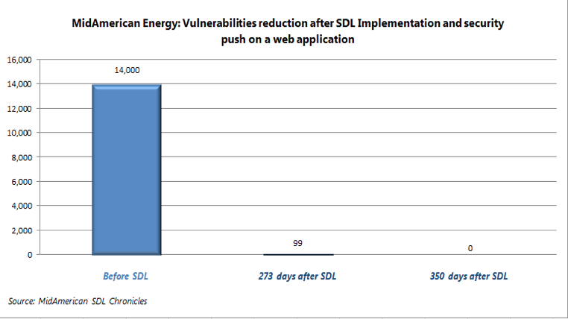
http://www.microsoft.com/security/sdl/learn/measurable.aspx
14

Slide 26
Agenda
Introduction to the Security Development Lifecycle (SDL)
SDL Phases and Practices
Training
Requirements
Design
Implementation
Veriﬁcation
Release
Response

Slide 27










Practice 1: Core Security Training
Training
Requirements
Design
Implementation
Veriﬁcation
Release
Response
Security knowledge is lacking in general
Historically not taught in universities
Barely taught in universities now
Capers Jones #1 education need “Security Vulnerability Prevention “
The attackers are getting smarter every day, security is a
moving target
Annual training is necessary
Need to cover all the topics in the SDL
http://www.webdesigncompany.net/websiteLoptimizationLmovingLtarget/

Slide 28












Practice 2: Security and Privacy Requirements
Training
Requirements
Design
Implementation
Veriﬁcation
Release
Response
These are process and team organization requirements, not technical requirements for the product.
Assign a security champion.
Assign a privacy advisor (external to team).
Assign a privacy lead (internal to team).

Slide 29




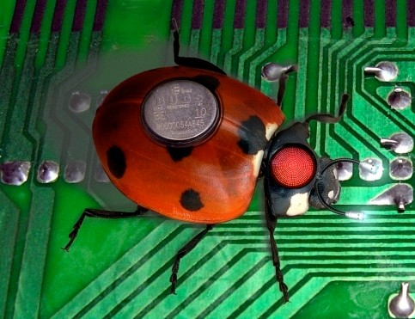
Practice 3: Create quality gates/bug bars
Training
Requirements
Design
Implementation
Veriﬁcation
Release
Response
Deﬁne and document a bug bar for security and privacy
Classiﬁcation of what are moderate, important, or critical security and privacy bug types
User to set priority for ﬁxing and to determine if the product can ship
Ensure that bug reporting tools can track security and privacy issues and that a database can be queried dynamically for all security bugs at any time
http://bakugan.wikia.com/wiki/File:ComputerLbug.jpg

Slide 30





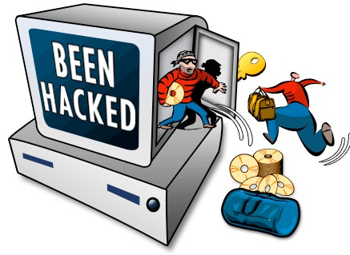
Practice 4: Security and Privacy Risk Assessment L 1
Training
Requirements
Design
Implementation
Veriﬁcation
Release
Response
Start a security plan. Identify timing and resources for SDL steps, such as:
Team training
Threat modeling
Security push
Final security review
Security Risk Assessment:
Identify speciﬁc functional areas that need special review

Slide 31




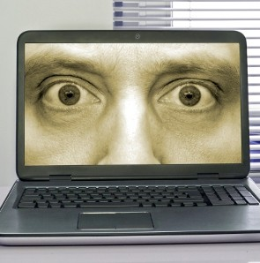
Practice 4: Security and Privacy Risk Assessment L 2
Training
Requirements
Design
Implementation
Veriﬁcation
Release
Response
Privacy Risk Assessment: Initial Privacy Impact Rating (PIR)
Stores personally identiﬁable information (PII) on the user's computer or transfers it from the user’s computer (P1)
Provides an experience that targets children or is attractive to children (P1)
Continuously monitors the user (P1)
Installs new software or changes ﬁle type associations, home page, or search page (P1)
Transfers anonymous data (P2)
None of the above (P3)
http://blogs.lawyers.com/2012/08/facebooksLprivacyLpolicyLwasLaLlieLsaysLtheLftc/computerLprivacyLsquare/

Slide 32




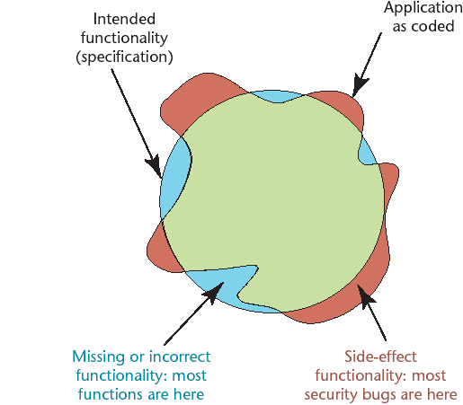
Phase Three: Design
Training
Requirements
Design
Implementation
Veriﬁcation
Release
Response
Thompson, Herbert, *, IEEE Security and Privacy, July/Aug 2003, pp. 83L86.

Slide 33


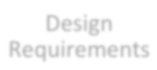






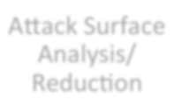



Phase Three: Three Cyclical Steps
Training
Requirements
Design
Implementation
Veriﬁcation
Release
Response
Design Requirements
Attack Surface Analysis/ Reduction
Threat Modeling
30

Slide 34



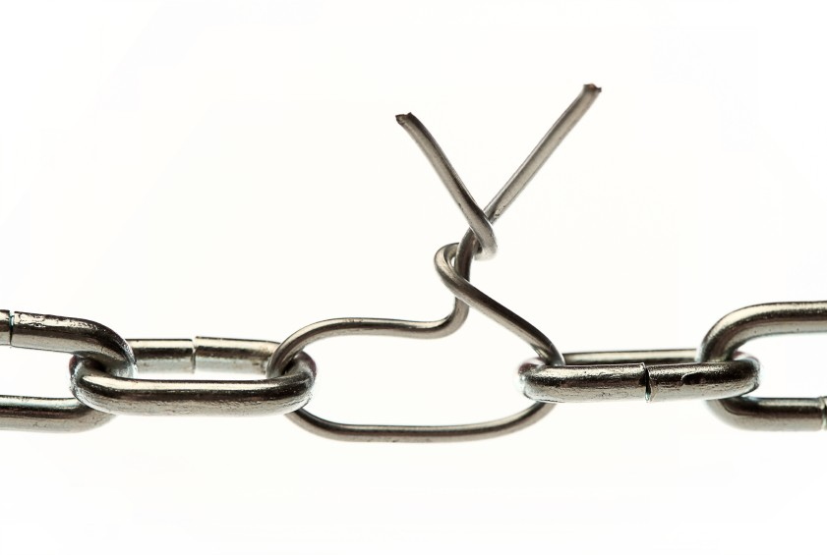
Practice 5: Establish design requirements
Training
Requirements
Design
Implementation
Veriﬁcation
Release
Response
Consider design principles, such as:
Least privilege
Compartmentalization
Validate/sanitize external input to the system
Log/audit system and data access
Reuse security components and libraries
Secure the weakest link
Leads to specification of:
Secure architecture
Identification of security critical components
Secure functional requirements
Security features (i.e. use of cryptography)
http://www.michiganemploymentlawadvisor.com/technologyLemploymentLissues/employeesLtheLweakestLlinkLinLtheLcompanyLdataL securityLdefense/

Slide 35










Practice 6: Attack surface analysis/ reduction
Training Requirements Design Implementation Veriﬁcation Release
Response
Fact: You will never ﬁnd all security issues through testing, and new attacks develop over time. The best
proactive strategy is to reduce a system’s attack surface.
A system’s attack surface has three abstract dimensions:
targets and enablers,
channels and protocols
access rights.
Attack Surface Analyzer (ASA) is one tool in a set of SDL tools that can provide information on the relative attack surface of your system.
http://www.isdecisions.com/products/userlock/beneﬁts.htm

Slide 36















Practice 7: Threat modeling
Training
Requirements
Design
Implementation
Veriﬁcation
Release
Response
Threat modeling is a process to understand (potential) security threats to a system, determine risks from those threats, and establish appropriate mitigations.
Diagramming
Validation
Threat enumeration
Mitigation

Slide 37




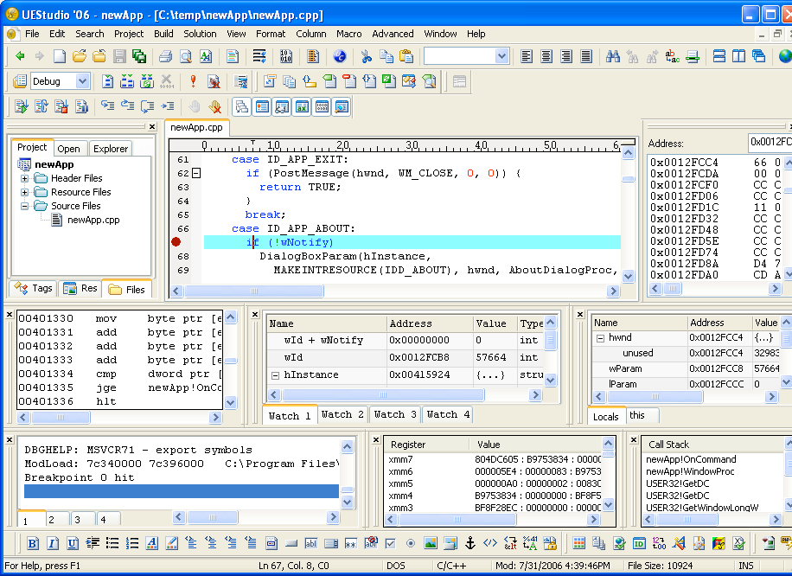
Practice 8: Use Approved Tools
Training
Requirements
Design
Implementation
Veriﬁcation
Release
Response
Speciﬁcation of approved build tools and options
Compilers and code generators
Static analysis
Debuggers
Dynamic analysis
Test veriﬁcation
IDE
Decide on settings and ensure settings are correct
Security isn’t static
Update your tools because they change with dynamic threat environment
http://www.ultraedit.com/support/tutorials_power_tips/uestudio/integrated_debugger.html

Slide 38




Practice 9: Deprecate Unsafe Functions
Training
Requirements
Design
Implementation
Veriﬁcation
Release
Response
Unsafe functions
– http://msdn.microsoft.com/enLus/library/bb288454.aspx
Banned API’s
Unsafe managed code
Best case, the use of these unsafe functions will be caught by a static analysis tool or compiler warnings … but learn them and avoid them, anyway

Slide 39



Practice 10: Perform Static Analysis
Training
Requirements
Design
Implementation
Veriﬁcation
Release
Response
“Code review with a tool”
Search through code to detect bug patterns (error prone coding practices that arise from the use of erroneous design patterns, misunderstanding of language semantics, or simple and common mistakes).
Increasingly being used to identify security vulnerabilities
Faster than manual code review; can be done more often
– Sometimes part of a quality gate before checking in code to the code base.
Don’t require the tool operator to have a high degree of security expertise

Slide 40





Practice 11: Perform Dynamic Analysis
Training
Requirements
Design
Implementation
Veriﬁcation
Release
Response
Run-time veriﬁcation necessary to ensure a program’s functionality works as designed
Black box testing: testing proceeds without knowledge of the code
Proper functioning of security features
Authentication
Encryption
Privacy controls
– …..

Slide 41















Practice 12: Fuzz Testing
Training
Requirements
Design
Implementation
Veriﬁcation
Release
Response
Malformed Input
Running Program
Response
Deliberately send attack strings to the program to see how the program will react.
Fuzz testing is black box testing.
Fuzz testing tools are available. The tools ﬁnd opportunities for input and will send attack strings.

Slide 42





Practice 13: Attack Surface Review
Training
Requirements
Design
Implementation
Veriﬁcation
Release
Response
Inevitably, the code won’t match the initial design
Use Attack Surface Analyzer (ASA) to analyze actual attack surface
Take corrective action if risks are revealed by this analysis
http://www.isdecisions.com/products/userlock/beneﬁts.htm

Slide 43



Practice 14: Incident Response Plan
Training
Requirements
Design
Implementation
Veriﬁcation
Release
Response
Creation of a clearly defined support policy
Prepare Cyber Security Incident Response Plan (CSIRP)
Identify contact for Cyber Security Council and resources to respond to incidents
24x7x365 contact information for engineering, marketing and management individuals with decision-making authority
Ensure ability to service all code “emergency” releases and all licensed 3rd party code.
40

Slide 44



Practice 15: Final Security Review
Training
Requirements
Design
Implementation
Veriﬁcation
Release
Response
Provide an independent view into “security ship readiness”
The Final Security Review (FSR) is
An examination of all SDL activities performed prior to release
Examination of threat models
Review of exception requests, security tool output, performance against bug bars
The Final Security Review (FSR) is NOT:
A penetration test – no “penetrate and patch” allowed
The ﬁrst time security is reviewed
A signoﬀ process
A “catchall” phase for missed work in earlier phases
Key concept: The tasks for this phase are used as a determining factor on whether or not to release

Slide 45




Practice 16: Release/Archive
Training
Requirements
Design
Implementation
Veriﬁcation
Release
Response
Security response plan complete
User documentation up to date
Archive as per your process necessary ﬁles and information:
– Examples: source code, symbols, threat models, etc
Complete ﬁnal signoﬀs
http://lildaveslife.blogspot.com/2011_11_01_archive.html

Slide 46




Practice 17: Execute Incident Response Plan
Training
Requirements
Design
Implementation
Veriﬁcation
Release
Response
“Plan the work, work the plan…”
“Plans are nothing; planning is everything.”
Dwight D. Eisenhower
”No battle plan survives contact with the enemy”
Colin Powell
Alas, some vulnerabilities may be discovered after release
Get ready to execute on response tasks outlined during Security Response Planning

Slide 47
Agenda
Introduction to the Security Development Lifecycle (SDL)
SDL Phases and Practices
Training
Requirements
Design
Implementation
Veriﬁcation
Release
Response
SDL Agile
Summary
36

Slide 48
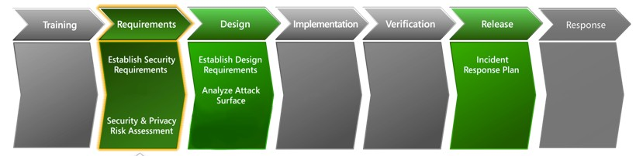
Agile: One time practices
Foundational security practices that must be established once at the start of every new Agile project.

Slide 49
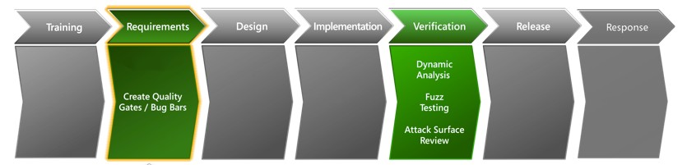
Agile: Bucket Practices
Important security practices that must be completed on a regular basis but can be spread across multiple sprints during the project lifetime.

Slide 50
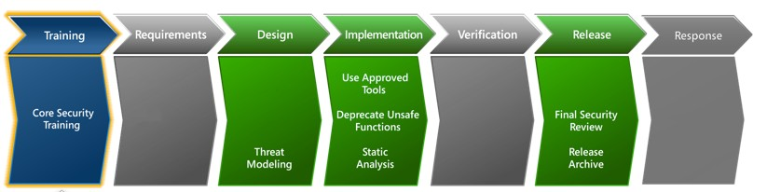
Agile: Every-Sprint Practices
Essential security practices that should be performed in every sprint.

Slide 51
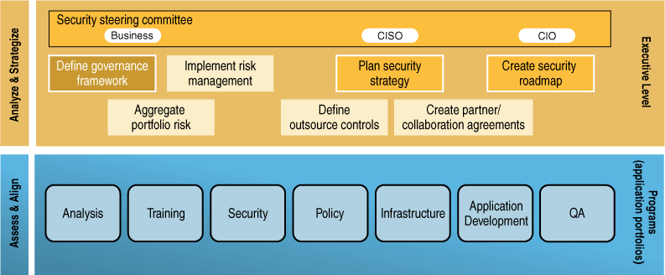
Enterprise Software Security Framework
Steven, John. “Adopting an Enterprise Software Security Framework.” IEEE Security & Privacy 4, 2 (March/April 2006): 84–87. https://buildsecurityin.us-cert.gov/daisy/bsi/resources/published/series/bsi-ieee/568.html
© 2012 Carnegie Mellon University
10

Slide 52
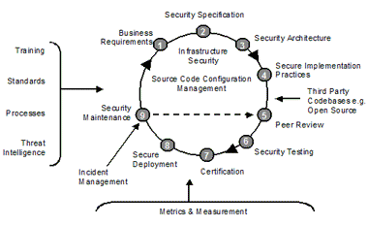
Assurent Software Security Lifecycle
http://www.assurent.com/index.php?id=59
© 2012 Carnegie Mellon University
13

Slide 53
Assess Security Risk Across the SDLC
Acquisition
Development
Implementation
RFP
design
testing
acceptance
concept
requirements
build
integration
operation
Security Risk Analysis
© 2012 Carnegie Mellon University
14
50

Slide 54
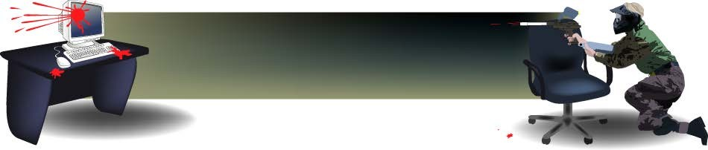
Attack Patterns
Blueprint for creating an attack (like a sewing pattern)
Consists of:
Attack prerequisites
Attack description
Related vulnerabilities
Method of attack
Skill & resources required to execute attack
Applicable contexts
Prevention & mitigation strategies
Consult CAPEC: Common Attack Pattern Enumeration and Classification http://capec.mitre.org/
© 2012 Carnegie Mellon University
15

Slide 55
Assurance Cases
Applicable during all phases of software development
Similar to a legal case
Presents arguments showing how a top-level claim is supported by evidence
The system is acceptably secure
The system has none of the common coding defects that lead to security vulnerabilities
Considers people, process, and technology
© 2012 Carnegie Mellon University
16

Slide 56
Misuse/Abuse Cases
Document a priori how software should react to illegitimate use (can’ts and won’ts)
Brainstorm with designers and software security experts
How does the software distinguish between good and bad input?
Between legitimate application vs. rogue application requests?
How can an attacker disrupt software communication interfaces?
Does the database server assume that the client manages all data access permissions?
Ask:
What assumptions are implicit in our system?
What things make our assumptions false?
What are some candidate attacks (consult attack patterns)?
Strike a balance between cost and value
Prioritize which cases to develop
Risk analysis helps guide case selection
© 2012 Carnegie Mellon University
17

Slide 57
Architecture & Design
Not the same as security architecture
architecture of security components (firewalls, IDS, other sensors, network monitoring points, etc.)
Architectural Risk Analysis
software characterization
threat analysis
architectural vulnerability assessment
risk likelihood determination
risk impact determination
risk mitigation planning
© 2012 Carnegie Mellon University
18

Slide 58
Secure Code Review/Scanning
Adopt a secure coding standard
Validate input
Perform bounds checking (buffer overflows)
Check for conditions that could lead to exceptions
Base access decisions on permission, not exclusion (default deny)
Enforce the principle of least privilege for processes
— Time out elevated privileges
Sanitize data sent to other systems
Guard against race conditions (infinite loops, deadlocks, resource collisions)
Review code against attack patterns & misuse/abuse cases
Conduct structured code inspections & peer review of source code
Use static source code analysis tools
© 2012 Carnegie Mellon University
19

Slide 59
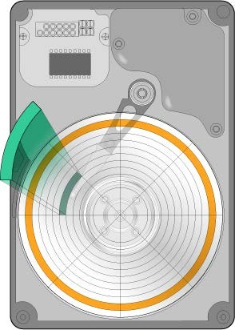
Security Testing - 1
Test approach & selection determined based on risk analysis
Use attack patterns & abuse cases
Emphasizes what an application should not do
“Unauthorized users should not be able to access data.”
Validate least privilege
Time-limited escalation of privilege
Disable account after x unsuccessful login attempts
© 2012 Carnegie Mellon University
20

Slide 60
Security Testing - 2
White box testing
validate design decisions & assumptions
analyze data, control, information flows; coding practices; exception & error handling
Black box testing
focus on externally visible behavior
examine requirements, protocols, interfaces, attempted attacks
vulnerability scanning is one example
Penetration testing (revised)
final production environment; final configuration
structured to demonstrate impact of likely risks
© 2012 Carnegie Mellon University
21

